Slide 1
Medium Fidelity Prototype
Honors College Connector App

Slide 2


User Login
Honors college logo will be added once acquired
Placeholder logo, can be changed
Recover Username and Password Options send users to the Oregon State University account recovery portal
ONID Username
ONID Password
Login
Forgot Username
Forgot Password

Slide 3







Homepage / Feed
-now with search filters
Event Title
Event Type
Date #/#
Short Description...
Presents different feed based on preferences
Colors will be limited to OSU colors.
Scrollability for viewing more than 3 entries
Represents the ability to add more events. Only for admin users.
The person amount indicates how many people have registered for the event thus far.
141
Register
AGSCI Panel
Science
11/19
OSU Agricultural Science Panel involving traditional practices...
122
Register
Workshop
HC Resume Review
12/8
Have an Honors College Representative look over your...
213
Register

Slide 4
Event Creation
New Event
John R. Doe
Event Name
View Saved Events
Location
Manage Notifications
Information page for all events
Can move # of people attending / workshop somewhere else on the screen if cluttered
Event type is a drop down with limited selection to promote uniformity.
Save for later allows admins to create an event and save it for later without publishing it.
Day/Time
Logout
Event Type
Upload Photo
Pick Color
Can add more settings here as needed. Accessible from every hamburger tab.
Some options such as ‘view saved events’ will only be for admins.
Qualtrics Link:
Description:
...
Save for later
Create Event

Slide 5

Event Info
HC Resume Review
-might be some confusion between what is a button and what is not a button.
Perhaps these are all clickable buttons. Workshop defined itself as the type of event, register allows users to register, # of people defines itself as the number of registered people when clicked, clicking location brings up a map, clicking time shows it in calendar view.
Information page for all events
Can move # of people attending / workshop somewhere else on the screen if cluttered
Workshop indicates the type of event and can range from academics to food.
Workshop
Register
213
LINC Room 111
12/8 1:00 PM
Have an Honors College Representative look over your resume and provide relevant feedback to help you secure future employment! Feedback will be in-person at a first come first serve interval. We hope to see you there!

Slide 6
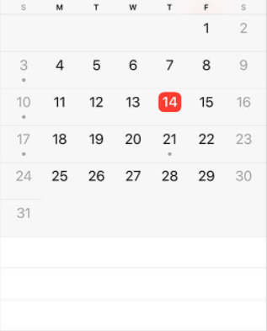
Registered Events
Registered Events
2021
November
Shows current events the user has registered for via two methods. Calendar format and list format.
Red box indicates the current day.
Orange outlined box indicates a day with a registered event.
Dots under day numbers will not be included, as they mean nothing in this context.
Considering G-Calendar integration.
AGSCI Panel, Nov 19
HC Resume Review, December 8

Slide 7
Notifications
Notifications
Upcoming Events
- AGSCI Panel, Nov 19
New Events
Alerts users to upcoming or new events. If the user registered for an event, they will be notified of an upcoming event 24 hours before the event begins. Users can change this update time in the settings dropdown.
Pings users on their home screen
- HC Resume Workshop, Dec 8
- Honors Mixer, Jan 12
Canceled Events
Events would also show as canceled on the calendar tab
- MU Picnic, Jan 14

Slide 8

Contact
Benjamin Hutkoff
hutkoffb@oregonstate.edu

Slide 9


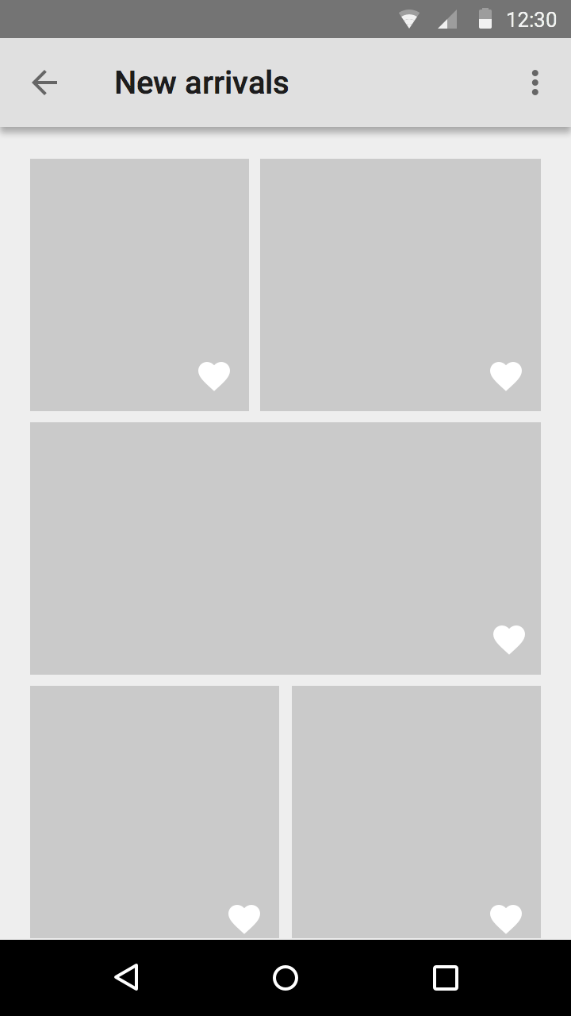
Visuals Page For Pasting
Simply here for access.
213
Register

